Slide 1
Ryan Svihla & Wei Deng
Highly Available Spark Streaming Processing with DataStax Enterprise and Confluent Platform

Slide 2
1 | PySpark sadness
2 | Streaming Points of Failure & Their Resolutions
3 | Anti-Patterns

Slide 3
PySpark Sadness
Our original talk

Slide 4
Kafka Direct API Issues
Python 2nd class citizen, simple java wrapper with direct api (version 1.4)
Python important features such as arbitrary offset support until 1.5

Slide 5
Driver HA: Cluster Mode
Cluster mode not available in standalone, so no supervise
Provides driver resilience which we cover use later but varying degrees of support with PySpark
Only available in Mesos SPARK-9669 (Spark 1.6.0)
And YARN SPARK-5162 (Spark 1.4.0)

Slide 6
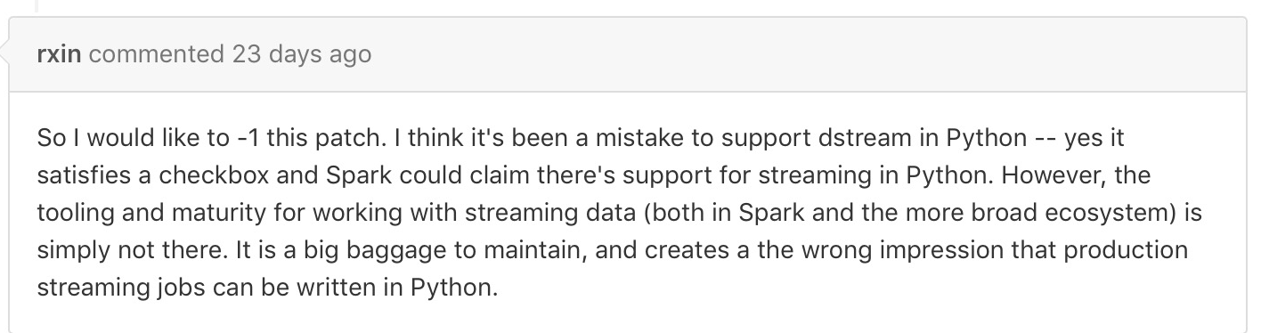
Kafka 0.10 Python support - SPARK-16534

Slide 7

So Scala
Supported & Agile
Like Python has a repl for iterative development
Lots of higher order functions
Unlike Python first class citizen of Spark
Gets all the features

Slide 8
Spark Streaming Points of Failure
Long running jobs and keeping them up

Slide 9
Spark Refresher
Component | Description
Driver | Where the application is launched and where results are fed
Master | Coordinates
Worker | Launches Executors
Executors | Spawn tasks to do work
Tasks | Unit of execution over partition

Slide 10
Points of failure and their resolutions
Failure mode | Resolution
Driver Failure | Cluster mode and supervise
Master Failure | DSE Leader Election
Worker Failure | Spark Master Handles this
Task Failure | Executors will retry
Cassandra Failure | Replicas > 1
Kafka Failure | Replicas > 1
ZooKeeper Failure | Replicas > 1
Message Loss | WAL or DirectAPI

Slide 11
Streaming considerations
Has to restart and pick up where it left off if master dies.
Default driver mode isn't fault tolerant.
Bad GC configuration (covered later in gotchas).
Ever growing state problems.
Message broker crashing and message loss.

Slide 12
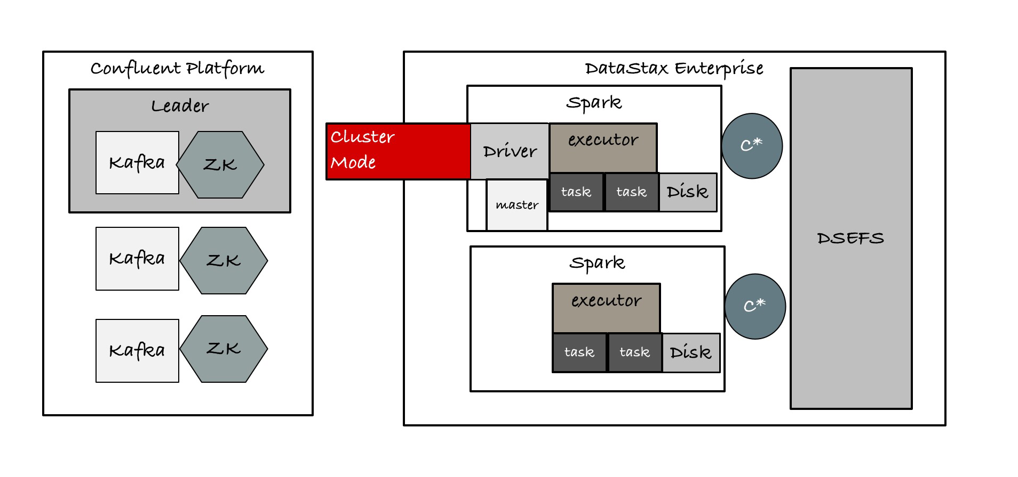
Cluster mode - Supervise
Summary
Restarts dead jobs
Runs inside an executor on a worker
Master is in charge of restarting driver on another worker
Gives us driver fault tolerance

Slide 13
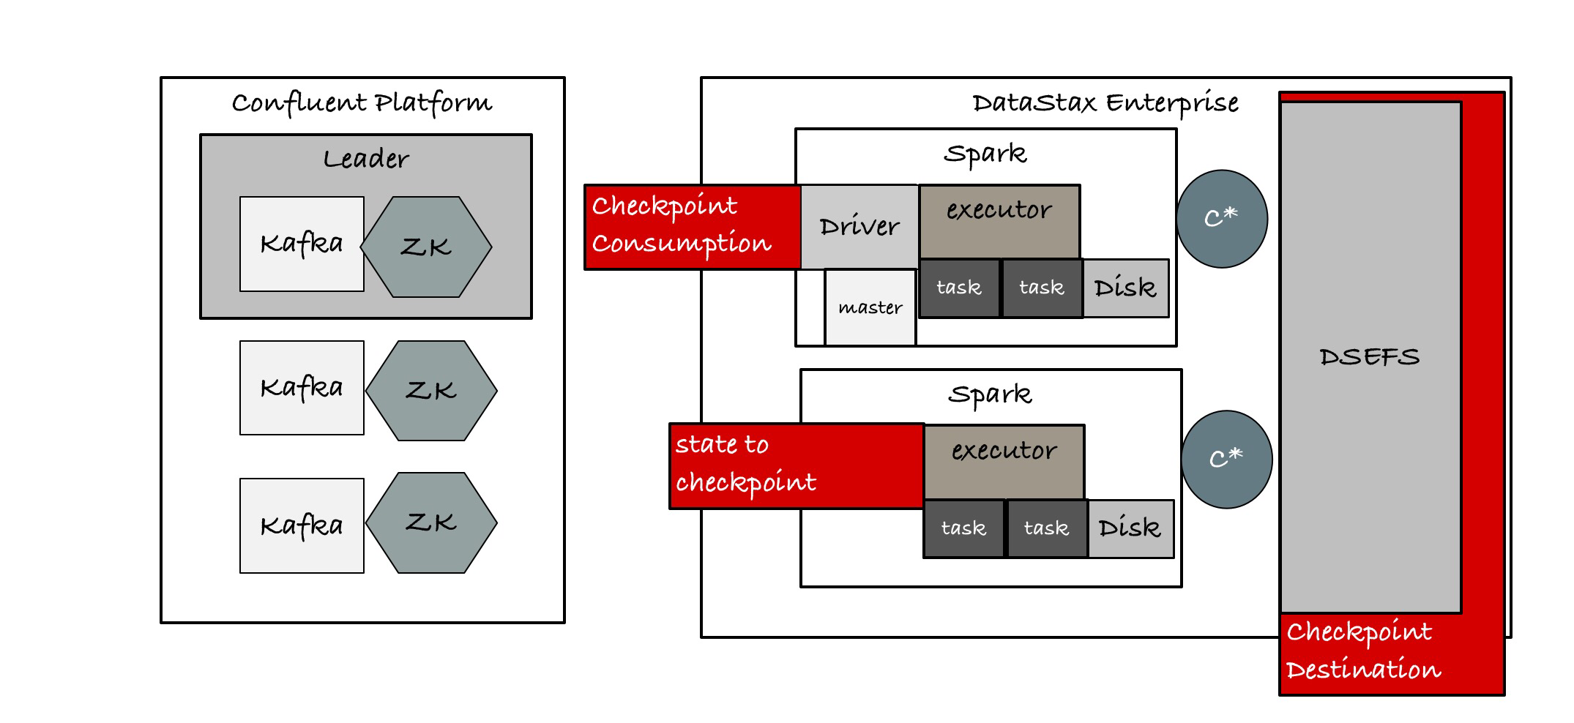
Checkpointing state
Summary
Ongoing calculations are preserved
Has to use a DFS (HDFS, DSEFS, S3)
Code has to be written to take advantage of it.

Slide 14
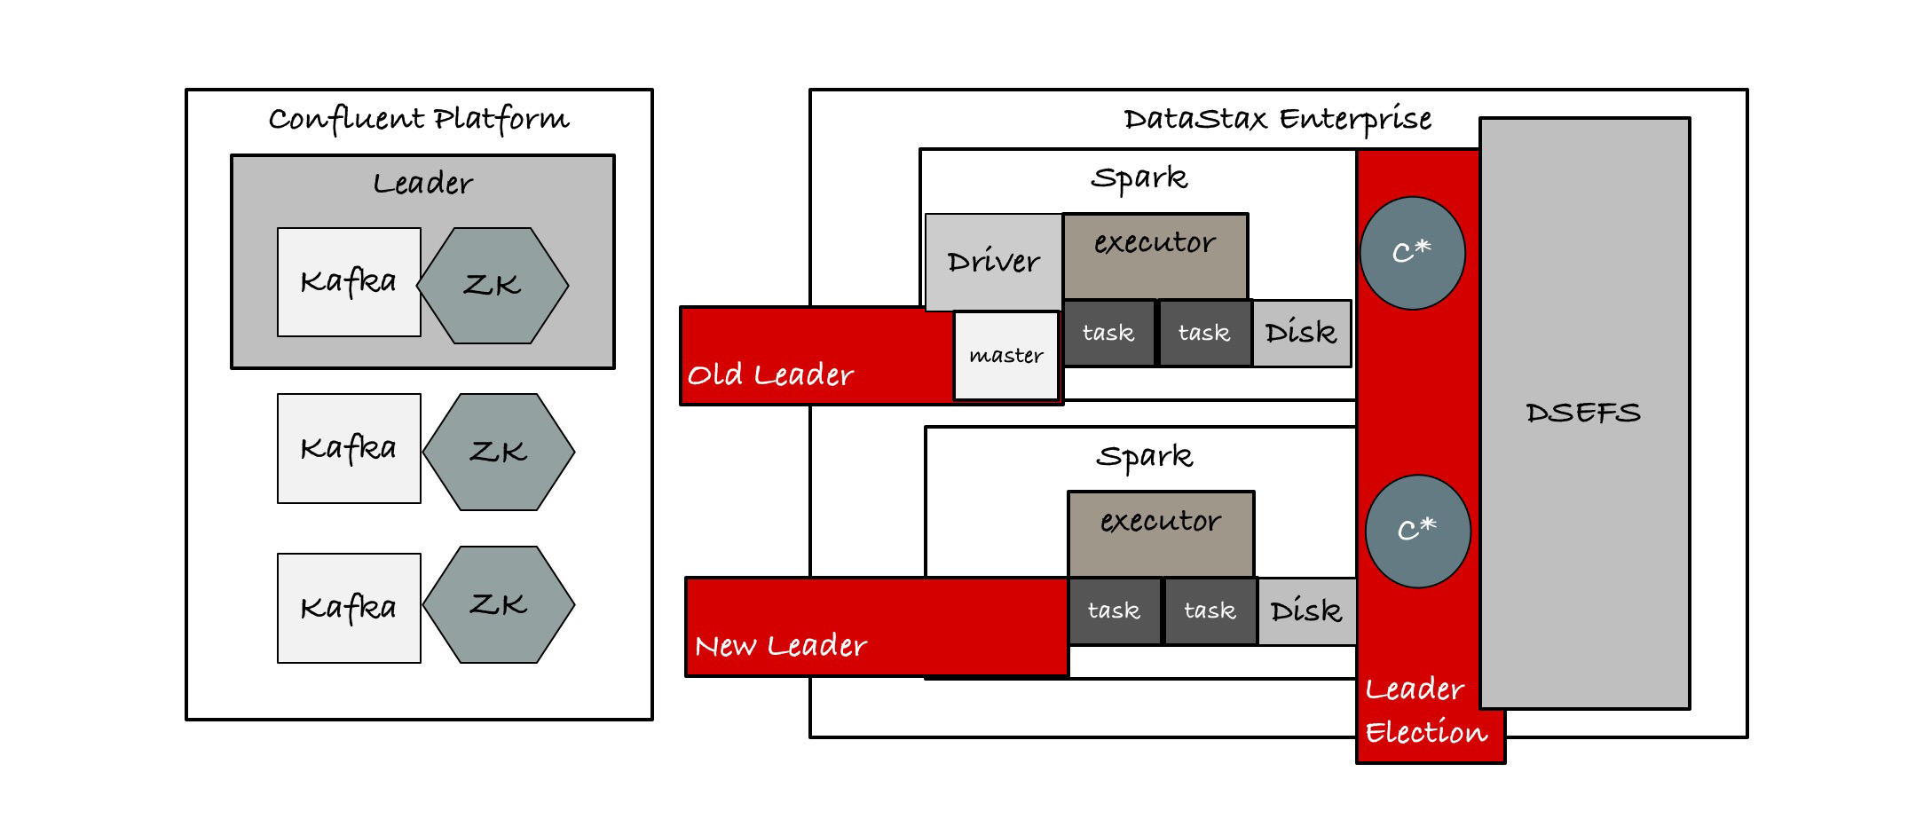
Master Leader Election
Summary
Gives us Spark Master fault tolerance
DSE 4.7+
Needs Quorum of Spark Nodes in data center to elect new master
Until DSE 4.7.9, 4.8.8, 5.0.0 can't restart driver that is also running on master

Slide 15
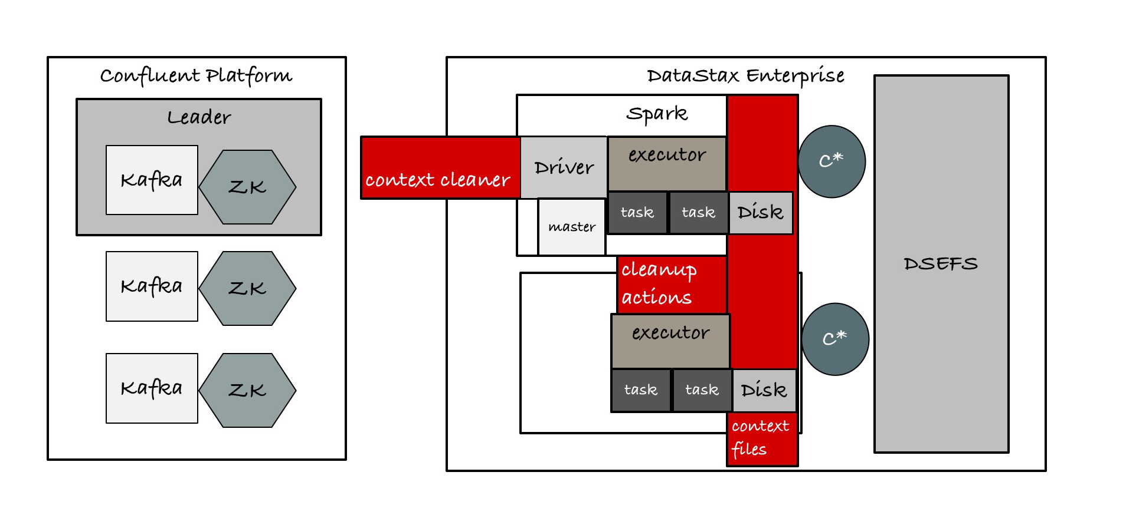
Context Cleaner
Summary
Eliminates a potential outage.
Removes no longer used shuffle data.
Removes no longer referenced RDDs that were persisted.
Executes on GC of the driver. So don't run too large of a driver heap.
Replaces TTL Cleaner which is deprecated in SPARK-10534

Slide 16
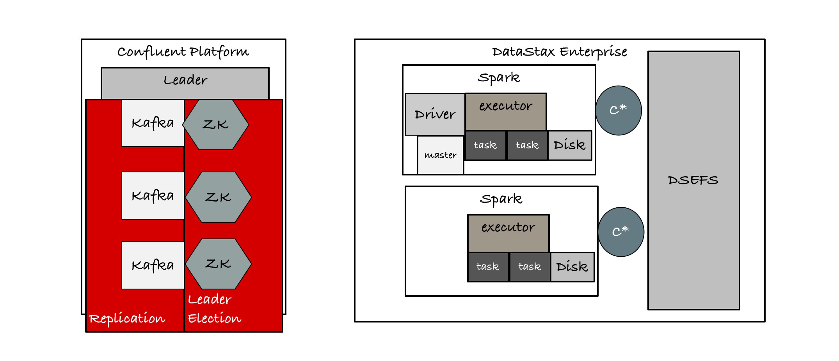
Kafka Replication
Summary
As of 0.8 ISR (In Sync Replica)
Leader/Follower Architecture
Relies on ZooKeeper for election
Can block till N replicas ack
Async otherwise
ISR has some interesting tradeoffs with leader election and durability. Know the boundaries.

Slide 17
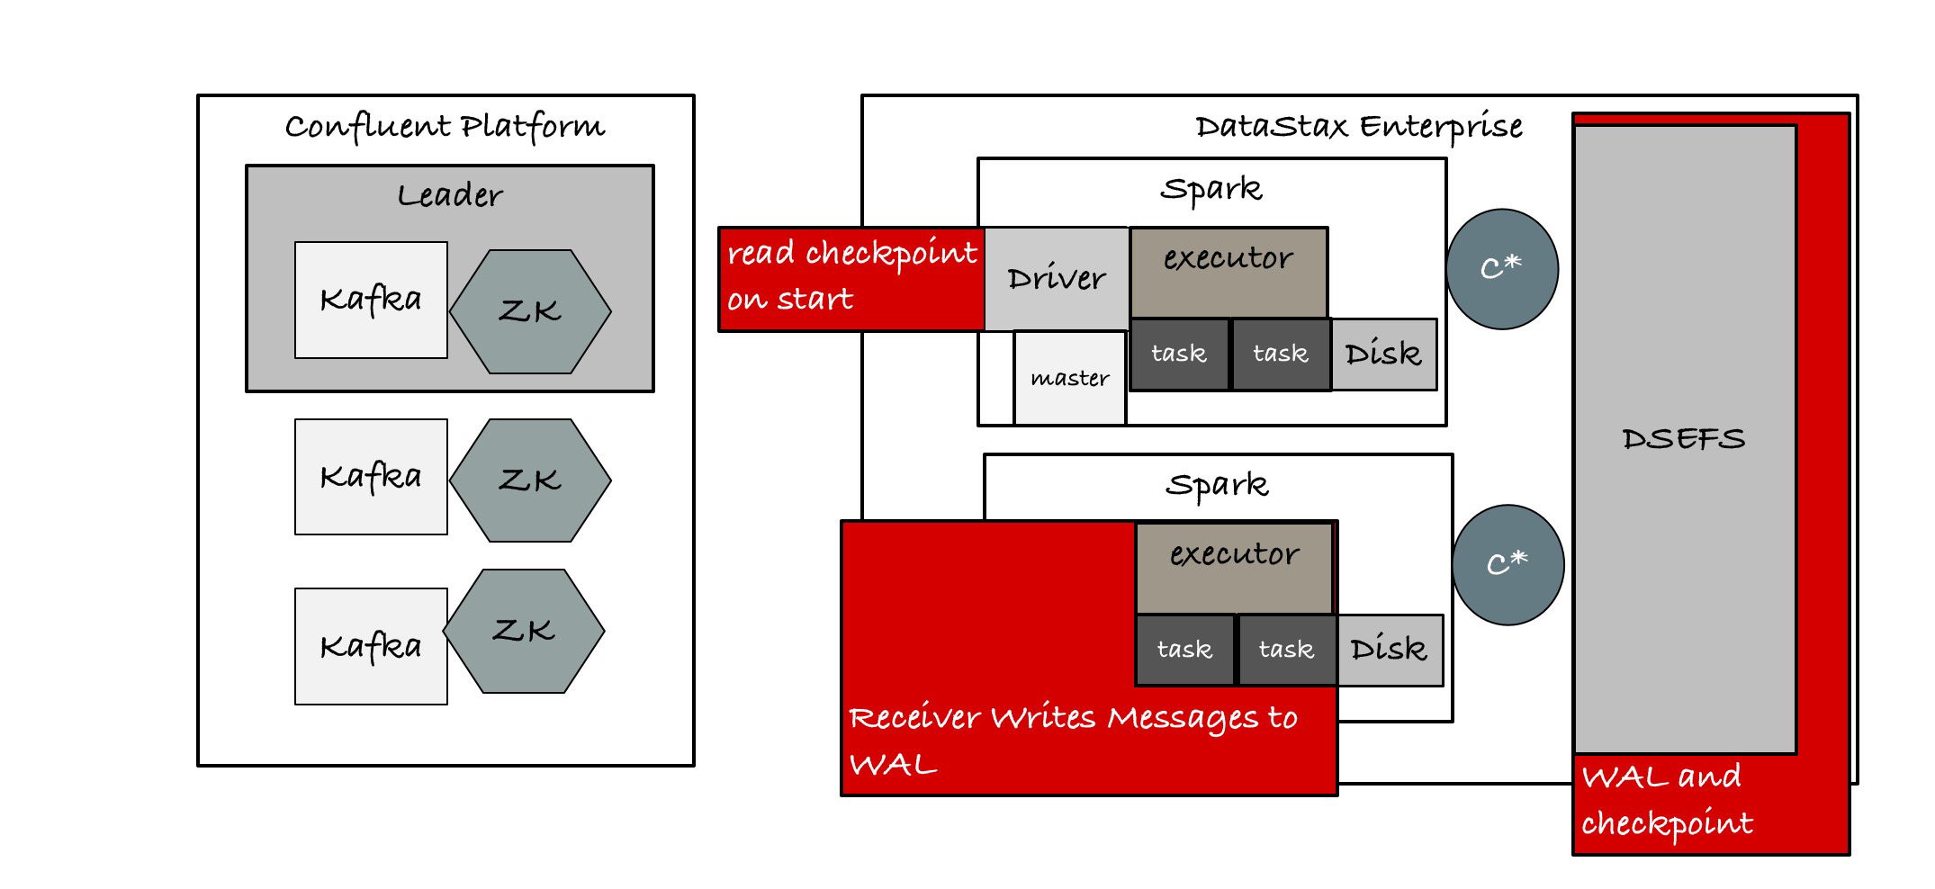
Messaging Failures: WAL
Write Ahead Log
Used with receivers.
Allows the message log to pick back up where it left off.
Slows down throughput a lot.
Still does nothing for handling double sent messages from an application perspective.
Requires DFS like HDFS, DSEFS or S3

Slide 18
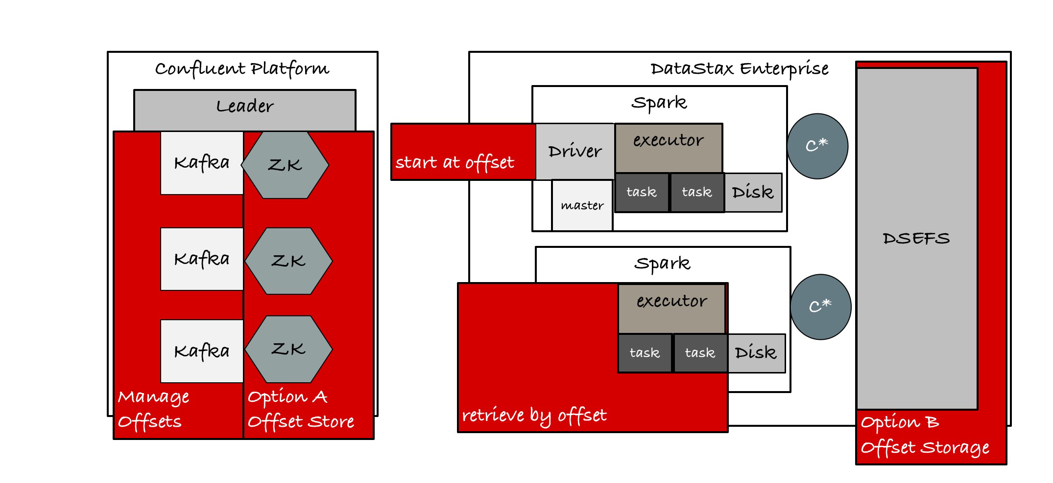
Messaging Failures: Direct API
Direct API
Exactly once messaging once it enters the pipeline.
Doesn't require DFS if you store offset in ZK. Option A
If you want to minimize message loss, checkpoint to DFS. Option B
Much faster throughput than WAL but experimental.
Much simpler tuning. 2 Kafka partitions for 2 parallel consumers.

Slide 19
Additional considerations for all jobs
Worker nodes crashing
Transient network failures
Cassandra nodes crashing
Cache regeneration

Slide 20
Spark Fault Tolerance: Workers (not really)
Master will stop sending work to Workers that aren't responding by timeout (default 60 seconds)
spark.worker.timeout 60
Tasks from crashed worker will be retried on another working node

Slide 21
Spark Fault Tolerance: Executors
Master will tell Worker to launch a replacement Executor if an Executor dies early
Any subtasks are rescheduled

Slide 22
Spark Fault Tolerance: Tasks
Individual tasks will be retried by the executor. Default of 4 times.
spark.task.maxFailures

Slide 23
Spark Fault Tolerance: Cache Replication
When caching can specify how many replicas you'd like.
Caching takes a lot more time because you have to copy the cache to another worker.

Slide 24
Gotchas
Beyond the textbook case

Slide 25

OOM: Out Of Memory
Summary
Small defaults for heap and GC in Spark
Some work doesn't split easily or has a large split
Also can be too much work in the driver
Asking executors to do too much

Slide 26
OOM: Small Defaults
Driver only 1gb heap available by default (as of 1.5.0). Should be enough for a lot of use cases.
Executors are only 1gb with Spark by default (as of 1.5.0). This is only usable for a small number of tasks. Set spark.executor.memory to a higher number for more flexibility with task sizes and better throughput.
Using G1GC plus a larger heap (32gb for example) should give you nice big executors that can do lots of work at once and handle a variety of workloads.

Slide 27
OOM: Large Spark Partitions
When the work cannot fit inside of a given task
Partitions that are larger than the available Executor heap
Sometimes I see people hit this trying to optimize throughput

Slide 28
OOM: Driver AKA don't call collect on 18TB
Common early mistake with Spark
It's often easier to debug work in the driver for new users
Or write out a file result locally instead of on a shared DFS
Easy to avoid don't call collect on large amounts of data. Write out large files to a DFS

Slide 29

Cassandra Anti-Patterns
Failures
Really Large Cassandra Partitions
Requiring all nodes to be up
Data center name mismatch

Slide 30
Cassandra Anti-Patterns: Very Large Partitions
But the Spark Cassandra Connector can split the work up (covered later).
IndexInfo can mean large heap pressure on Cassandra underneath CASSANDRA-9754 with large partitions. Looking at multiple gigabytes.
Pre 3.0 versions of Cassandra column names can make a large difference in partition size (compression helps)
If you run a large enough ParNew in CMS with the correct tuning or a large enough heap in G1 (26gb+) this is fine. Otherwise large partitions can cause a job to not be able to complete.

Slide 31
Cassandra Anti-Patterns: Bad RF and CL Combination
LOCAL_QUORUM/QUORUM with less than RF3 or using ALL
Means all nodes have to be up to complete your work.
There is now no fault tolerance for node outages.
One node drops your job is failing.

Slide 32

Out of Disk aka "Drive Space isn't Infinite!?"
Failures
Bad data skew on shuffle.
Ever growing state.
Job History Server without Cleanup

Slide 33
Out of Disk: Bad data skew
Shuffle will flush intermediary data to local disk (this is why fast SSDs are a good idea)
Group by a limited range like "active" and "inactive".
One of those will grow indefinitely and you'll need an impossibly large node to handle it.

Slide 34
Out of Disk: Driver Heap Is Huge
Context cleaner requires the driver to GC to actually fire a cleanup job
If you set heap large enough this may not happen soon enough relative to disk space

Slide 35
Out of Disk: Job History Server w/o cleanup
Pretty easy to set
spark.history.fs.cleaner.enabled true #need it enabled)
spark.history.fs.cleaner.interval 1d #check once a day
spark.history.fs.cleaner.maxAge 7d #clean files over 7 days old

Slide 36

Reading Too Aggressively
Summary
Watch out for large rows (covered earlier)
spark.cassandra.input.fetch.size_in_rows default 1000 may need to drop for large rows
spark.cassandra.input.split.size_in_mb if Spark doesn't have enough heap

Slide 37

Writing Too Aggressively
Summary
This can be about just too much write volume in the first place
Also look at spark cassandra connector settings
Modern connector setting is output.batch.size.bytes 1024 and spark.cassandra.output.concurrent.writes 5 this is pretty safe. If this isn’t set or if the row number is set it can be bad.
Old versions set output.batch.size.rows new versions this is auto.

Slide 38

Infinite Retry
Summary
SPARK-5945 it was possible in spark for stages to get stuck retrying forever.
Fixed in DSE-5.0

Slide 39
Summary
Try not to shoot yourself in the foot
Use a durable broker.
Use a durable database.
Use a distributed filesystem.
Use direct API or WAL or have some other method of message replay
Don't use Python for HA Spark Streaming :(

Slide 40
Thank You
Go forth and be stable

